Slide 1
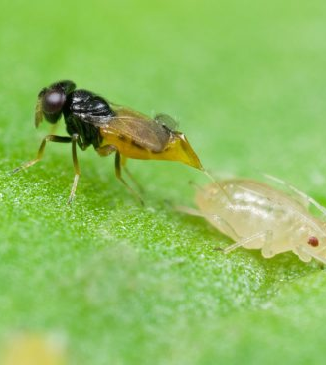
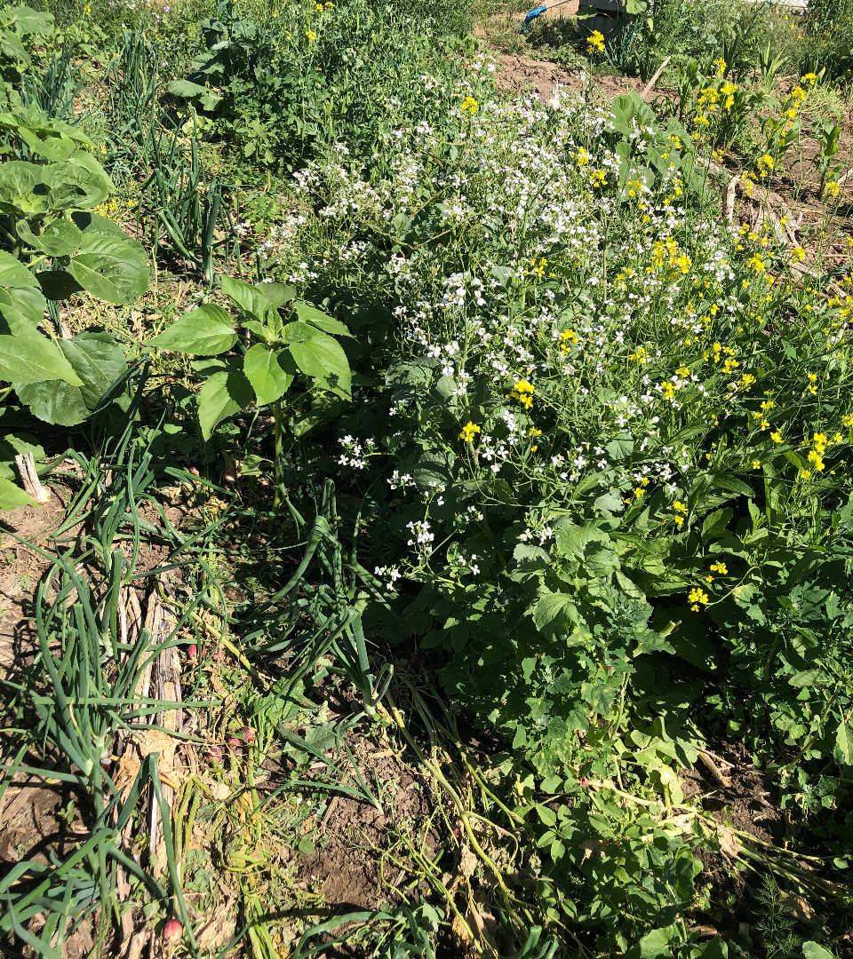
Cover Crops Addressing
Pest Management Concerns
Notes:
Cover crop picture: M. Winger

Slide 2
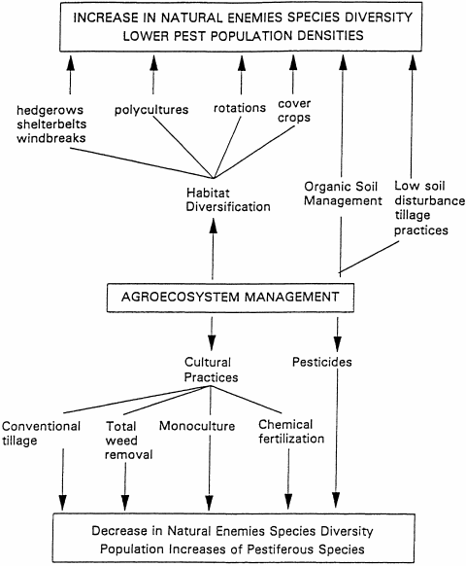
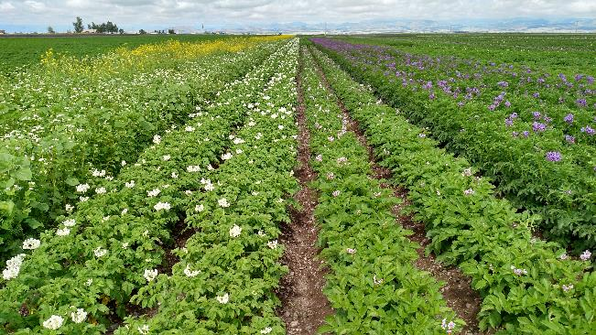
Cover crop strip. Brendon Rockey, CO
Altieri M.A. The ecological role of biodiversity in agroecosystems. Agriculture, Ecosystems & Environment 74: 19-31
Notes:
Good to watch B. Rockey youtube for this slide.
We have all be taught the bottom have of the management scenario, but Dr. Altieri is suggesting a different way.
Crop rotation is potato , full season cover crop
An example of planting a full season cc that flowers thoughout the year to provide habitat for parasitic (beneficial insects). the cover crop is a 12 foot row of cc planted trough the center of the pivot and also around the peremiter of the pivot

Slide 3
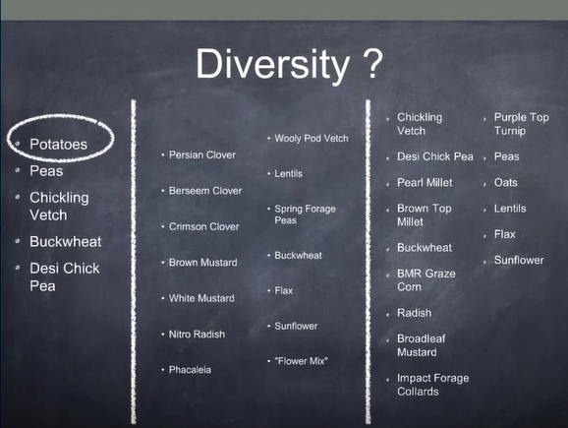
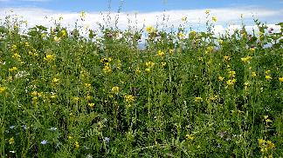
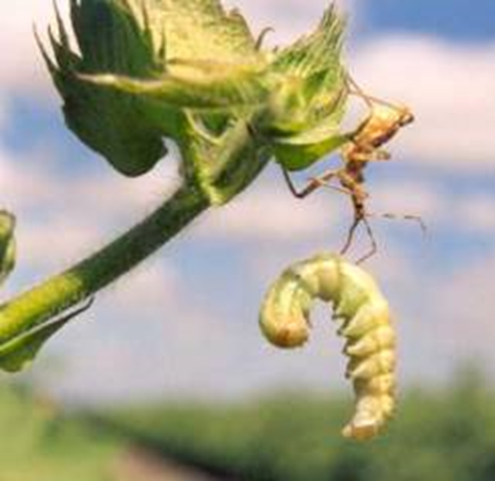
Brendon Rockey, Alamoso, CO
Notes:
Brendon plants 4 cover crops with his potatoes and plants a flowering mix of cover crops down the center of the field and around the edge of the pivots. The right side of the cc slide is his diverse mix of cc planted in the potato, cover crop rotation
If you have beneficials they can do the work for you, if youo don't promote their habitat you got to spend money to do their job

Slide 4
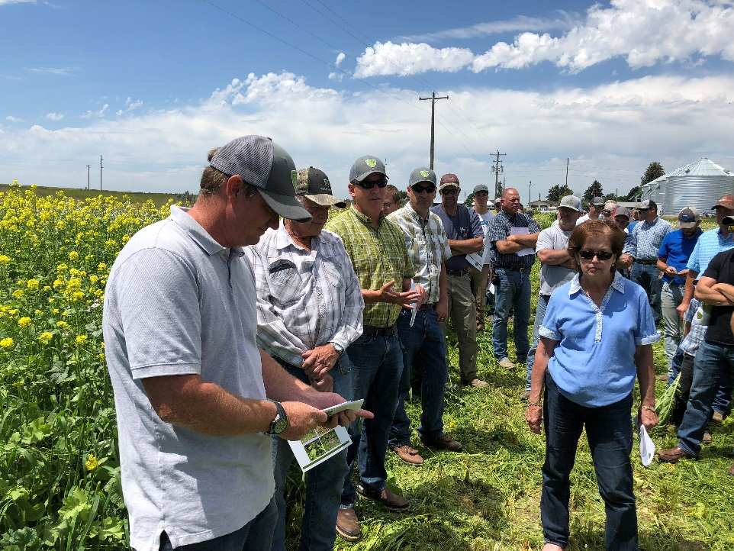
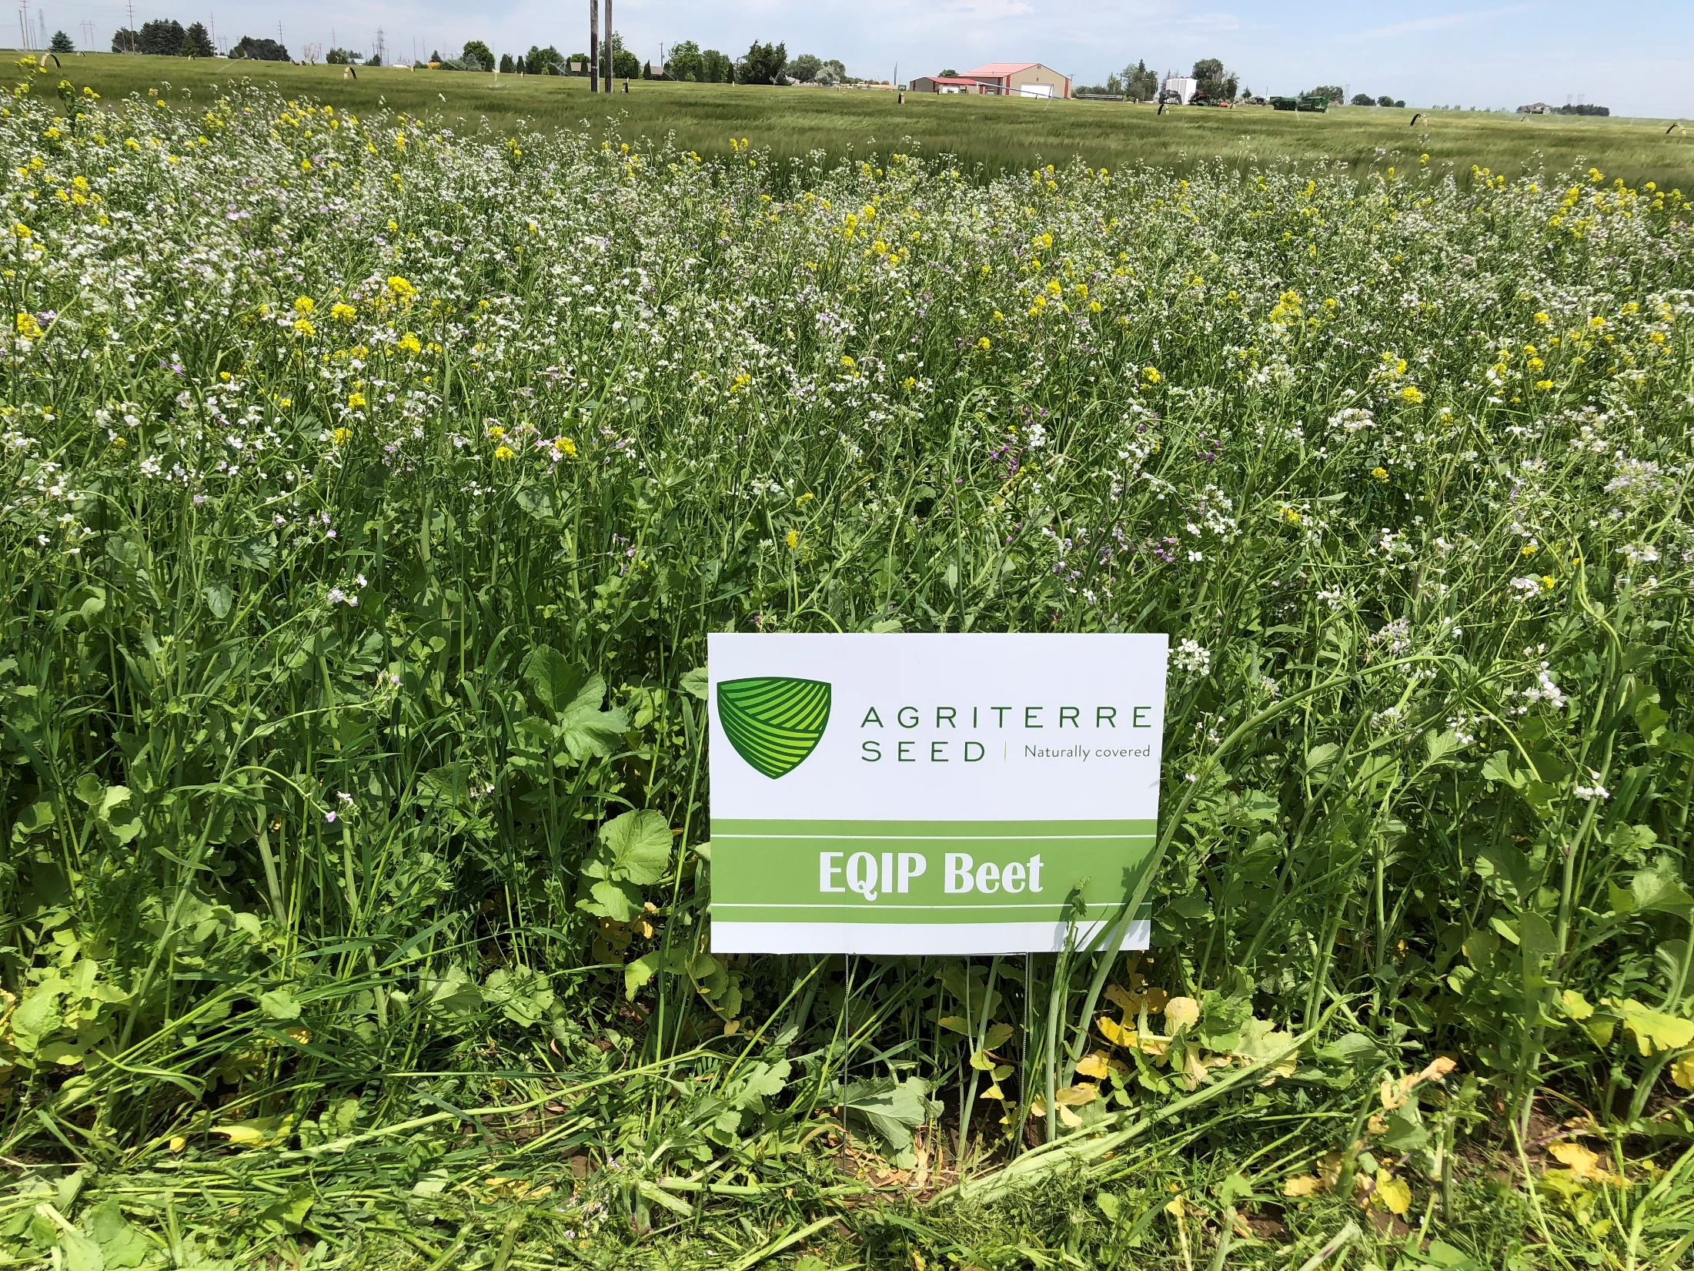
Selected Cover Crops Trap Sugar Beet Cyst Nematode (SBCN)
Specific cover crops selected release exudates to signal Nematode egg hatch
CONCORDE oil radish stimulates Sugar beet cyst nematode (SBCN) cysts containing hundreds of eggs, to develop but prevents the nematodes from completing their life cycle.
RESISTANCE Our cover crops provide no nutrition for nematodes. While this has no impact on plant health (or the benefits to your field) it reduces or eliminates nematode reproduction, dramatically lowering nematode counts.
TRAP CROP The “trap” is set by stimulating the SBCN eggs and larvae present in the soil to develop without being able to complete their life cycle in what it perceived to be a host plant — but isn’t.
Photos: M. Winger
Allied Seed Variety Product Guide 2017
Notes:
Cover crops that act as a trap crop for sugar beet cyst nematode, but also look at the flowering potential for beneficial insect populations

Slide 5
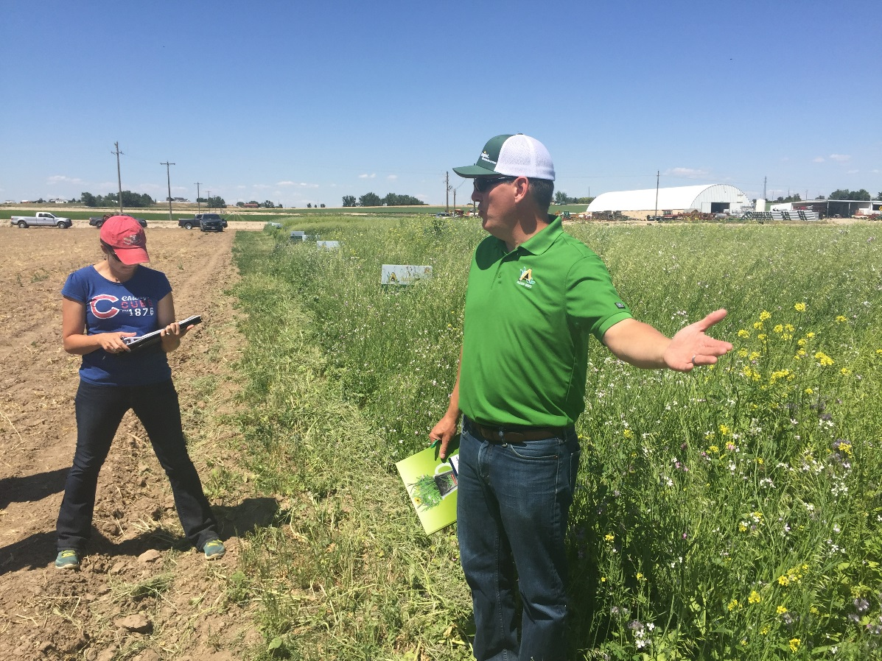
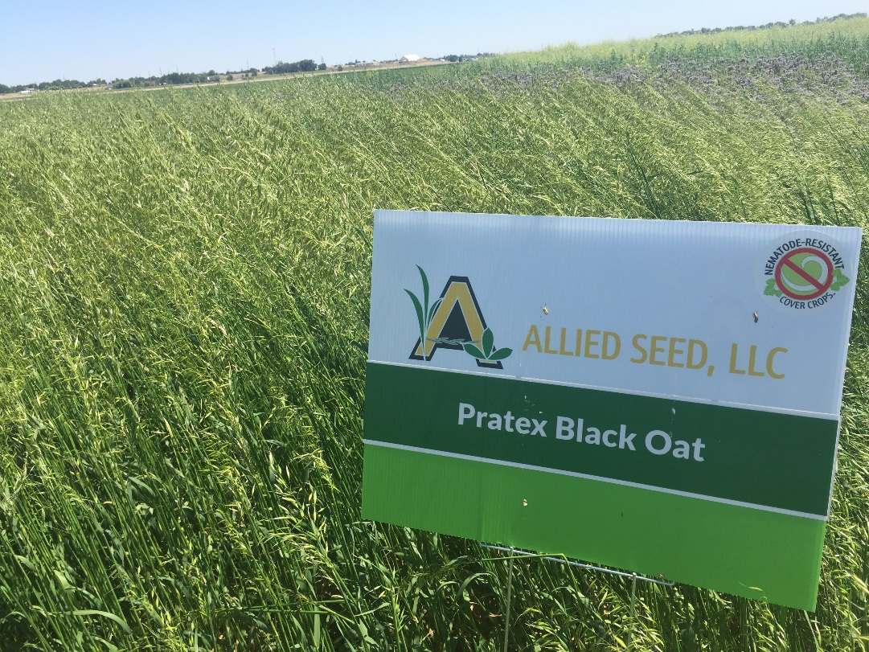
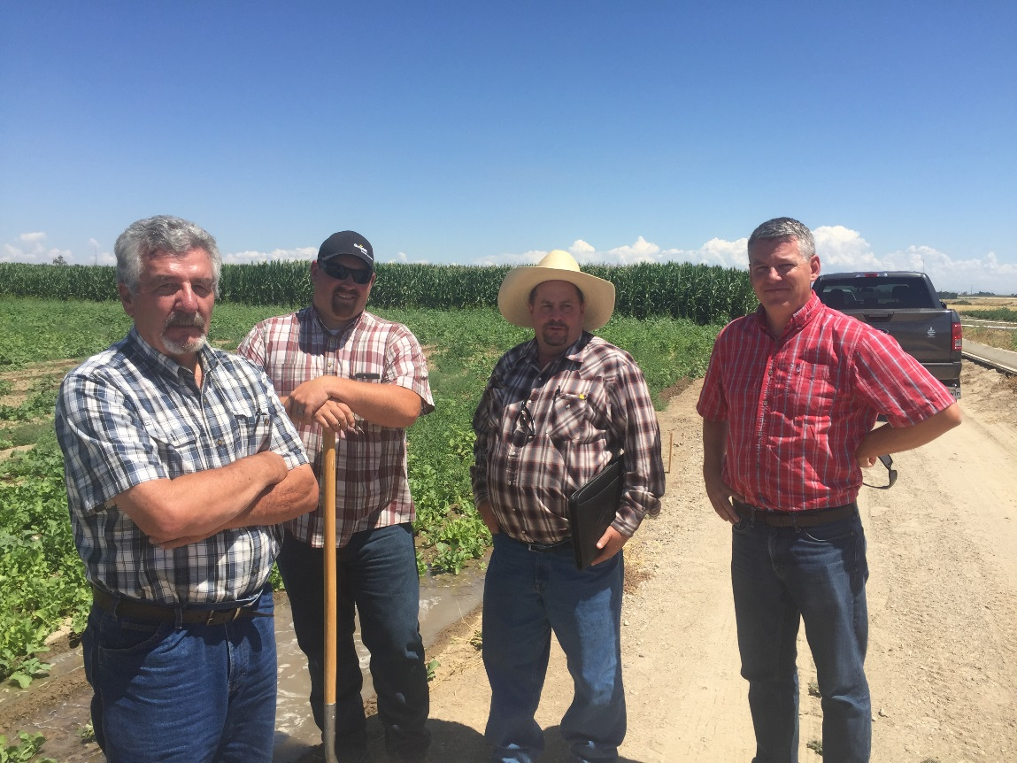
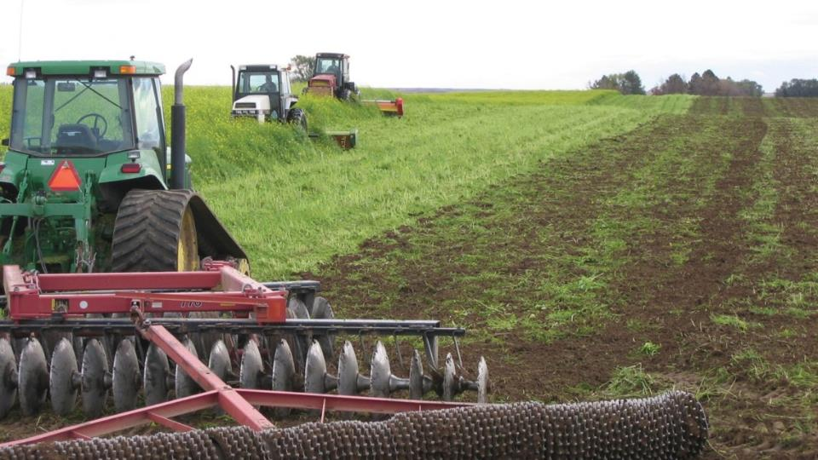
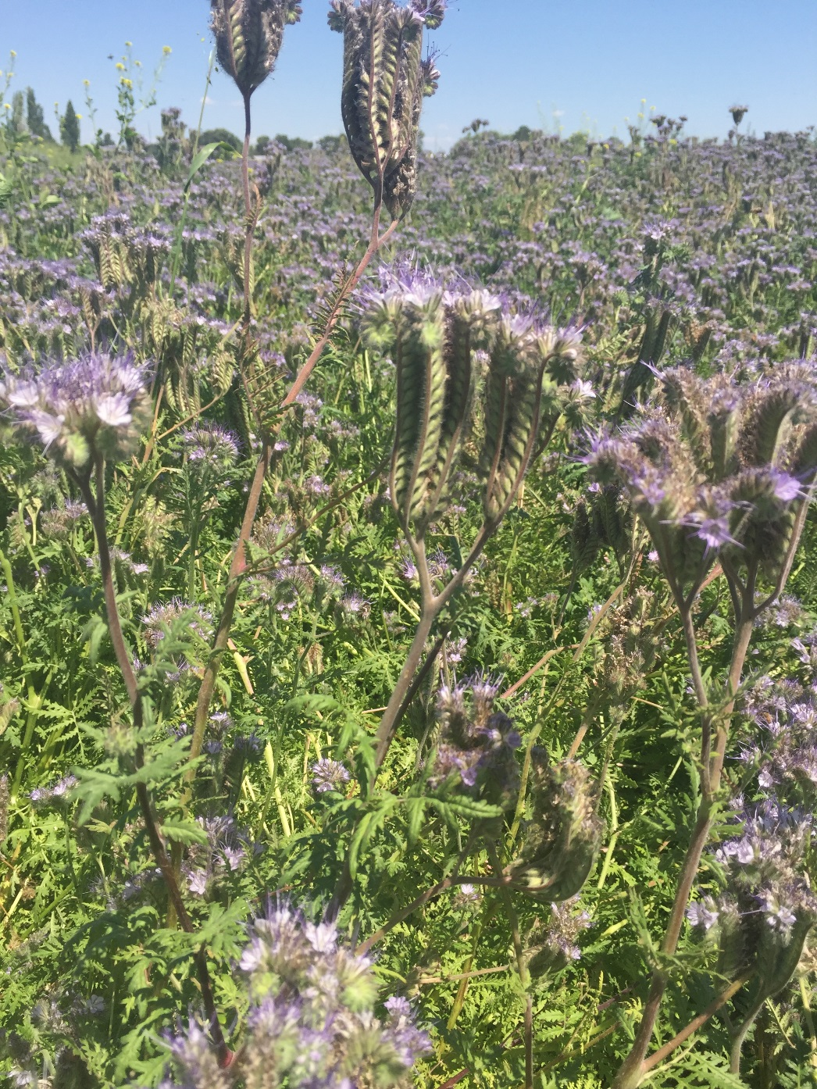
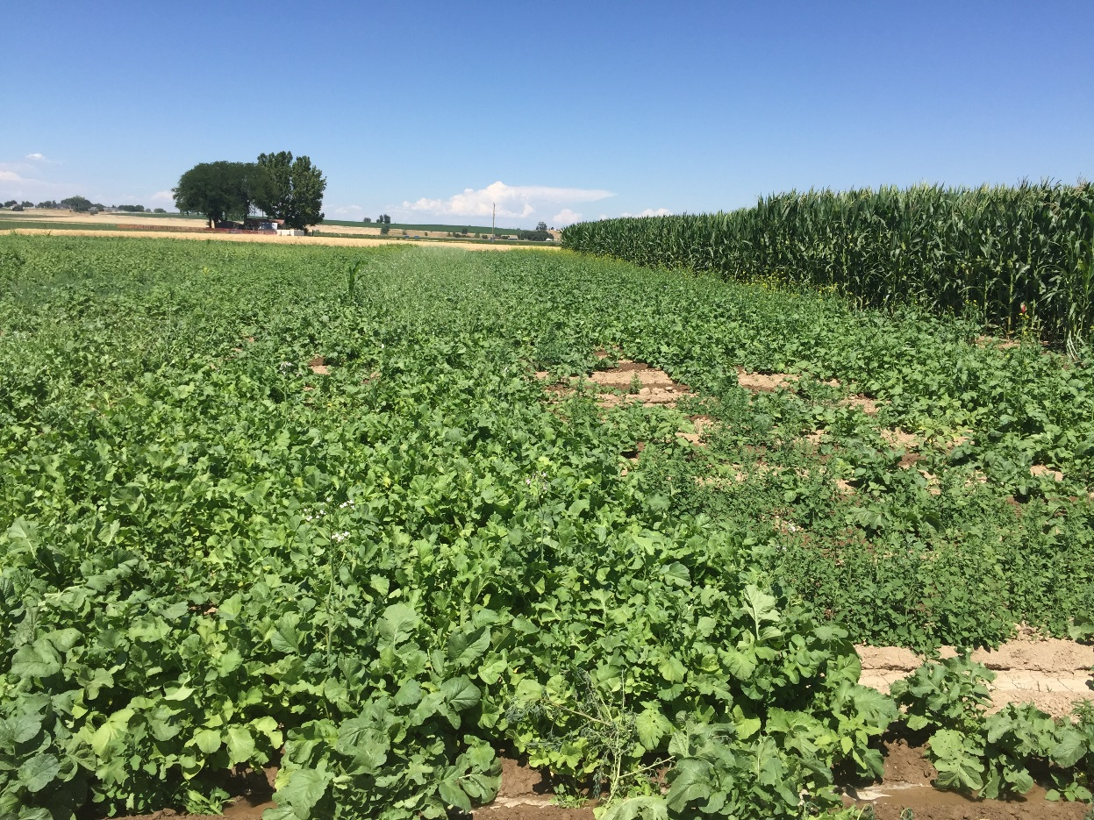
Biofumigation white mustard, oriental mustard, pacific gold
Nematode Resistant Cover crops
Radish varieties
Photo: Andy McGuire, WSU
Notes:
Regarding planting rates on these, Marlon and I calculated that a 40 lb per acre rate is sufficient. For simplicity, plant the 50 lbs on one acre for both mixes; this will not have a negative impact on anything. The “standard” planting time would be after wheat harvest but we’re just trialing (and photo ops) this and wanting to get a look at it before the summer push. In the Treasure Valley, we will have some of these mixes planted next week. I’d estimate that in your area, you have another two to three weeks up to the first part of May. We’ll let these grow about 8 weeks before they’d have to be terminated.
This is what is in the Beet mix along with the percentages. CONCORDE radish and MASTER mustard reduce significantly the sugarbeet cyst nematodes (SBCN). ANGELIA phacelia is neutral (no increase in populations and insignificant decrease in pops) along with berseem, flax and common vetch. The PRATEX oats will not affect SBCN either way but they will decrease Stubby Root Nematode and Root Lesion Nematodes.
Here is what the Potato mix consist of and percentages. In this mix, CONTROL radish, MASTER mustard, common vetch and flax all will reduce Columbia Root Knot Nematode (CRKN). CONTROL radish will have the biggest reduction. The PRATEX oat are neutral towards CRKN but again, they reduce Stubby Root and Root Lesion. Stubby Root is the vector for Tabaco Rattle Virus which leads to Corky Ring Spot in spuds.
Thanks,
Kent O. Whittig
Allied Seed LLC
9311 Hwy 45
Nampa, ID 83686
Andy McGuire WSU
Mustard Green Manures Replace Fumigant and Improve Infiltration in Potato Cropping System
Andrew M. McGuire ^{*a}
+ Author Affiliations
a Washington State University Cooperative Extension, Grant-Adams Area, PO Box 37, Ephrata WA 98823
Andy McGuire WSU
Mustard Green Manures Replace Fumigant and Improve Infiltration in Potato Cropping System
Andrew M. McGuire ^{*a}
+ Author Affiliations
a Washington State University Cooperative Extension, Grant-Adams Area, PO Box 37, Ephrata WA 98823
Abstract
In potato (Solanum tuberosum) production, farmers often use expensive fumigants to control soilborne pests. Mustard green manures may offer farmers an equally effective, but less expensive, alternative to fumigants for control of these pests. In a spring wheat (Triticum aestivum)-potato rotation, potato (Russet Norkotah) yields following white mustard (Sinapis alba Martigena) or oriental mustard (Brassica juncea Cutlass) green manures averaged 32.5 tons/acre with or without the soil fumigant metam sodium. An average of 86% of the tubers met the US #1 grade (>4 oz). Infiltration rates for soils receiving mustard green manures were from 2 to 10 times greater than those not receiving green manures. In similar potato cropping systems, farmers replacing metam sodium with mustard green manures could potentially improve their soil's infiltration rate while saving an estimated $66/acre.
Potato Yields, With and Without Fumigant
Three trials were conducted to compare the existing, proven technology, metam sodium, with the new technology of mustard green manures to suppress Verticillium dahliae, under conditions where metam sodium would normally be used. One trial took place in 1999-2000, and two other trials, differing only in the type of mustard used, took place in 2000-2001. The fields had produced three (1999-2000 trial) or six (2000-2001 trials) previous potato crops, grown in the wheat/mustard-potato rotation described above. Russet Norkotah, a relatively short season, fresh market potato cultivar, was grown in these fields. It is considered susceptible to Verticillium dahliae/potato early dying (11).
Since the trials were carried out under center-pivot irrigation systems, leaving plots without mustard would have required either giving up randomization of the treatments or adding confounding factors associated with leaching and nitrogen levels. Therefore, the two treatments, with (+) and without (−) fumigant, both followed mustard.
The trials were conducted following spring wheat in two fields, 25 acres (1999) and 20 acres (2000), under center-pivot sprinkler irrigation. The fields were planted to white mustard Martigena (1999 and 2000), or oriental mustard Cutlass (2000). The mustards were planted in mid-August at approximately 10 lb/acre. The sum of residual soil-N and applied fertilizer-N was 120 lb/acre and adequate soil moisture was maintained through irrigation. Volunteer wheat was killed using a selective herbicide. In late October, the mustard was flail-chopped and immediately disk-incorporated with two passes into moist soil.
Aboveground biomass yields for the mustard were 5564 and 4773 lb dry matter/acre for Martigena (1999 and 2000, respectively) and 5023 lb dry matter/acre for Cutlass (2000).
The following March (2000 and 2001), metam sodium was applied to the fields with a ground applicator at 37.5 gal/acre. The entire field was fumigated except for plots 200+ ft long by 28 ft wide (two passes of the applicator), where the flow of the fumigant was turned off. These plots were paired with similarly sized fumigated plots and were set up perpendicular to the direction of the potato rows and replicated six (2000) or five (2001) times. The order of the paired treatments, with (+) and without (−) fumigant, was randomized yielding a complete randomized block design. Management was equal in all plots after the application of the fumigant and was similar to other potato operations in the region.
Potatoes (Russet Norkotah) were planted the third week of April with 10.5-inch in-row spacing and 34 inches between rows. In early to mid September, the potatoes from ten feet of row were dug by hand from each plot, graded, and weighed. The same row was harvested from all plots to avoid any planting differences between rows. Statistical analysis of the data showed that there were no significant differences between the potato yields of the two treatments in any of the three trials. Nor were there any statistically significant differences in the harvested tuber size classes. The total yields, averaged across the treatments, were 31.6, 34.2, and 31.6 tons/acre, respectively, for the three trials, with 82%, 88%, and 88%, respectively, of the tubers meeting the US #1 grade (>4 oz). These yields are above the average yields for Grant County in those years (16), which were 30.5 (2000) and 30 tons/acre (2001).
Without metam sodium treatment, serious losses due to potato early dying would be expected from the combination of multiple potato crops with a susceptible potato clone in a two-year rotation. Furthermore, analysis of soil from the 2001 trials confirmed the presence of damaging levels of V. dahliae. Soil samples taken from these trials were sent to a lab that assayed the levels of V. dahliae using methods reported in Johnson et al. (5). The results were reported in colony forming units (CFU) per gram of dry soil. Average pre-plant levels (4 April 2001) after mustard were 10 and 22 CFU/g, for the (+) fumigant and (−) fumigant plots respectively (no significant difference). Samples from an unreplicated fallow area (without mustard) showed 18 CFU/g. According to the scientist doing this analysis, fields planted to the potato Russet Burbank in this region, with 13 CFU/g, would be considered at high risk of yield losses from potato early dying (P.B. Hamm, personal communication, 2003). Russet Burbank is considered moderately resistant to V. dahliae, therefore the threshold for Russet Norkotah may be even lower.
These results suggest that, in this cropping system, the mustard green manure by itself can suppress Verticillium dahliae sufficiently to maintain potato yields, and that metam sodium after a mustard green manure does not further increase crop yield. This conclusion is supported by the fact that despite conditions favoring significant yield loss to potato early dying, the measured yields exceeded the county averages, which include the yields of many potato crops grown under more favorable conditions. Furthermore, metam sodium is used on over 50% of the potato acreage in Washington (9), usually in situations less risky than this one because the yield decreases due to Verticillium wilt have been well documented (12). Therefore, it is reasonable to assume that yields would have been below the county average if the Verticillium had not been suppressed by either the mustard green manure or the metam sodium.
Two further assumptions are required to support this conclusion. First, that the mustard green manure did not reduce yields. This assumption is supported by the fact that the potato yields were above average for the county and they were produced in a short two-year rotation that would not normally be recommended. Second, that the mustard green manure did not reduce the effectiveness of the fumigant. This is not likely in this system where the green manure is incorporated in October and the fumigant is applied five months later in the following March. We believe these assumptions and the conclusion are reasonable.
Cost of the Mustard Green Manure and Expected Savings
The total estimated production cost for the mustard green manure is $93/acre (Table 2). Although this includes the cost of the fertilizer applied to the mustard, a portion of the nutrients incorporated in a green manure crop will become available to the following crop. Thus, a portion of the $38/acre spent on nitrogen fertilizer may be recovered by reduced nitrogen requirements in the following crop. Although we have not yet quantified this nutrient cycling, the 2001 potato crop required (based on petiole nutrient sampling) only 160 lb N/acre, applied as fertilizer. This is much less than the 250+ lb N/acre that is normally applied to potato crops in this region and suggests that a significant amount of nitrogen from the green manure is being utilized by the potato crop.
View Full Table | Close Full ViewTable 2.Estimated variable costs for a mustard green manure (per acre, 2002).
ItemUnitCost/unitQuantityMustardNormalSeedlb$2.3510$23$0Plantingacre$6.101$6$0Fertilizerlb$0.38100$38$0Herbicideacre$15.001$15$0Irrigation poweracre-inch$1.789$16$5Choppingacre$6.001$6$6Disking/packingacre$5.002$10$10Total:$114$21Mustard cost over normal practice:$93ª Costs normally incurred following wheat harvest.
This nutrient cycling reduces the cost of the green manure, but the amount of nitrogen cycled is difficult to estimate because it will vary with crop growth and the climatic conditions preceding potato planting. A common recommendation is that farmers can expect 50% of the nitrogen incorporated in a green manure to become available for the following crop (14). Using this estimate and an average of 100 lb N/acre in the mustard green manure crops, the expected reduction in the potato N requirement would be about 50 lb/acre. An additional savings of $140+/acre will occur if the mustard replaces the metam sodium. A partial budget analysis for the replacement of metam sodium by mustard green manures (Table 3) shows an overall savings of $66/acre.
View Full Table | Close Full ViewTable 3.Partial budget for the replacement of metam sodium by a mustard green manure.
Partial Budget, per acreAdditional costsAdditional revenuesMustard green manure$93NoneReduced revenueReduced costsNoneMetam sodium application$14050 lb N/acre fertilizer, at $0.38/lb$19A. Total additional costs and reduced revenue$93B. Total additional revenue and reduced costs$159Net change in income (B-A):$66
Conclusions
The findings suggest potential for mustard green manures to replace the fumigant metam sodium for the production of potatoes in some cropping systems. The practice can also improve water infiltration rates and provide substantial savings to farmers. While these results should not be extrapolated to longer rotations, longer-season potatoes, or to different soil types without further verification, they are promising and warrant further study into the use of mustard green manures for control of soilborne pests in potato and other cropping systems. Related work on the management of mustard green manures may be found online at the Grant-Adams website of WSU Extension (17).

Slide 6
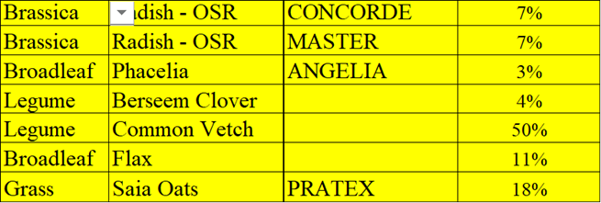
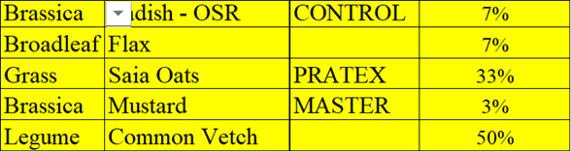
Cover crop Mixes for Sugarbeet Cyst & Columbia Root Knot Nematodes
Table 1. Cover crops to reduce Sugarbeet Cyst Nematode
Table 2. Cover crops to reduce Columbia Root Knot Nematode
CONCORDE radish and MASTER mustard reduce significantly the sugar beet cyst nematodes (SBCN). ANGELIA phacelia is neutral (no increase in populations and insignificant decrease in pops) along with berseem, flax and common vetch. The PRATEX oats will not affect SBCN either way, but they will decrease Stubby Root Nematode and Root Lesion Nematodes.
CONTROL radish, MASTER mustard, common vetch and flax all will reduce Columbia Root Knot Nematode (CRKN). CONTROL radish will have the biggest reduction. The PRATEX oat are neutral towards CRKN but again, they reduce Stubby Root and Root Lesion. Stubby Root is the vector for Tabaco Rattle Virus which leads to Corky Ring Spot in spuds.
Notes:
Information from: Kent Whittig, Allied Seed, Nampa, Idaho

Slide 7
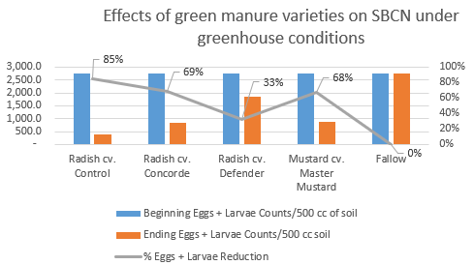
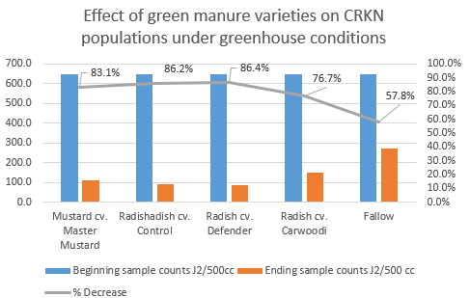
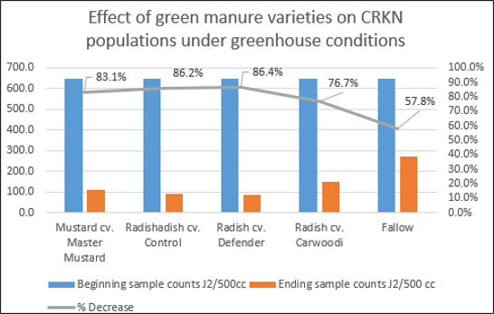
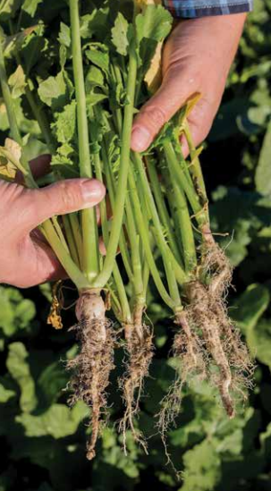
Various cover crop species effect on pest nematodes in sugar beet and potato crops
Sugar beet Cyst Nematode (SBCN)
Columbia Root Knot Nematode (CRKN)
University of Idaho, Unpublished data, 2016
Notes:
P.H. Peterson, Germany is seed supplier
Graphs show beginning and ending eggs and larva counts of Sugarbeet cyst and Columbia root knot nematodes

Slide 8
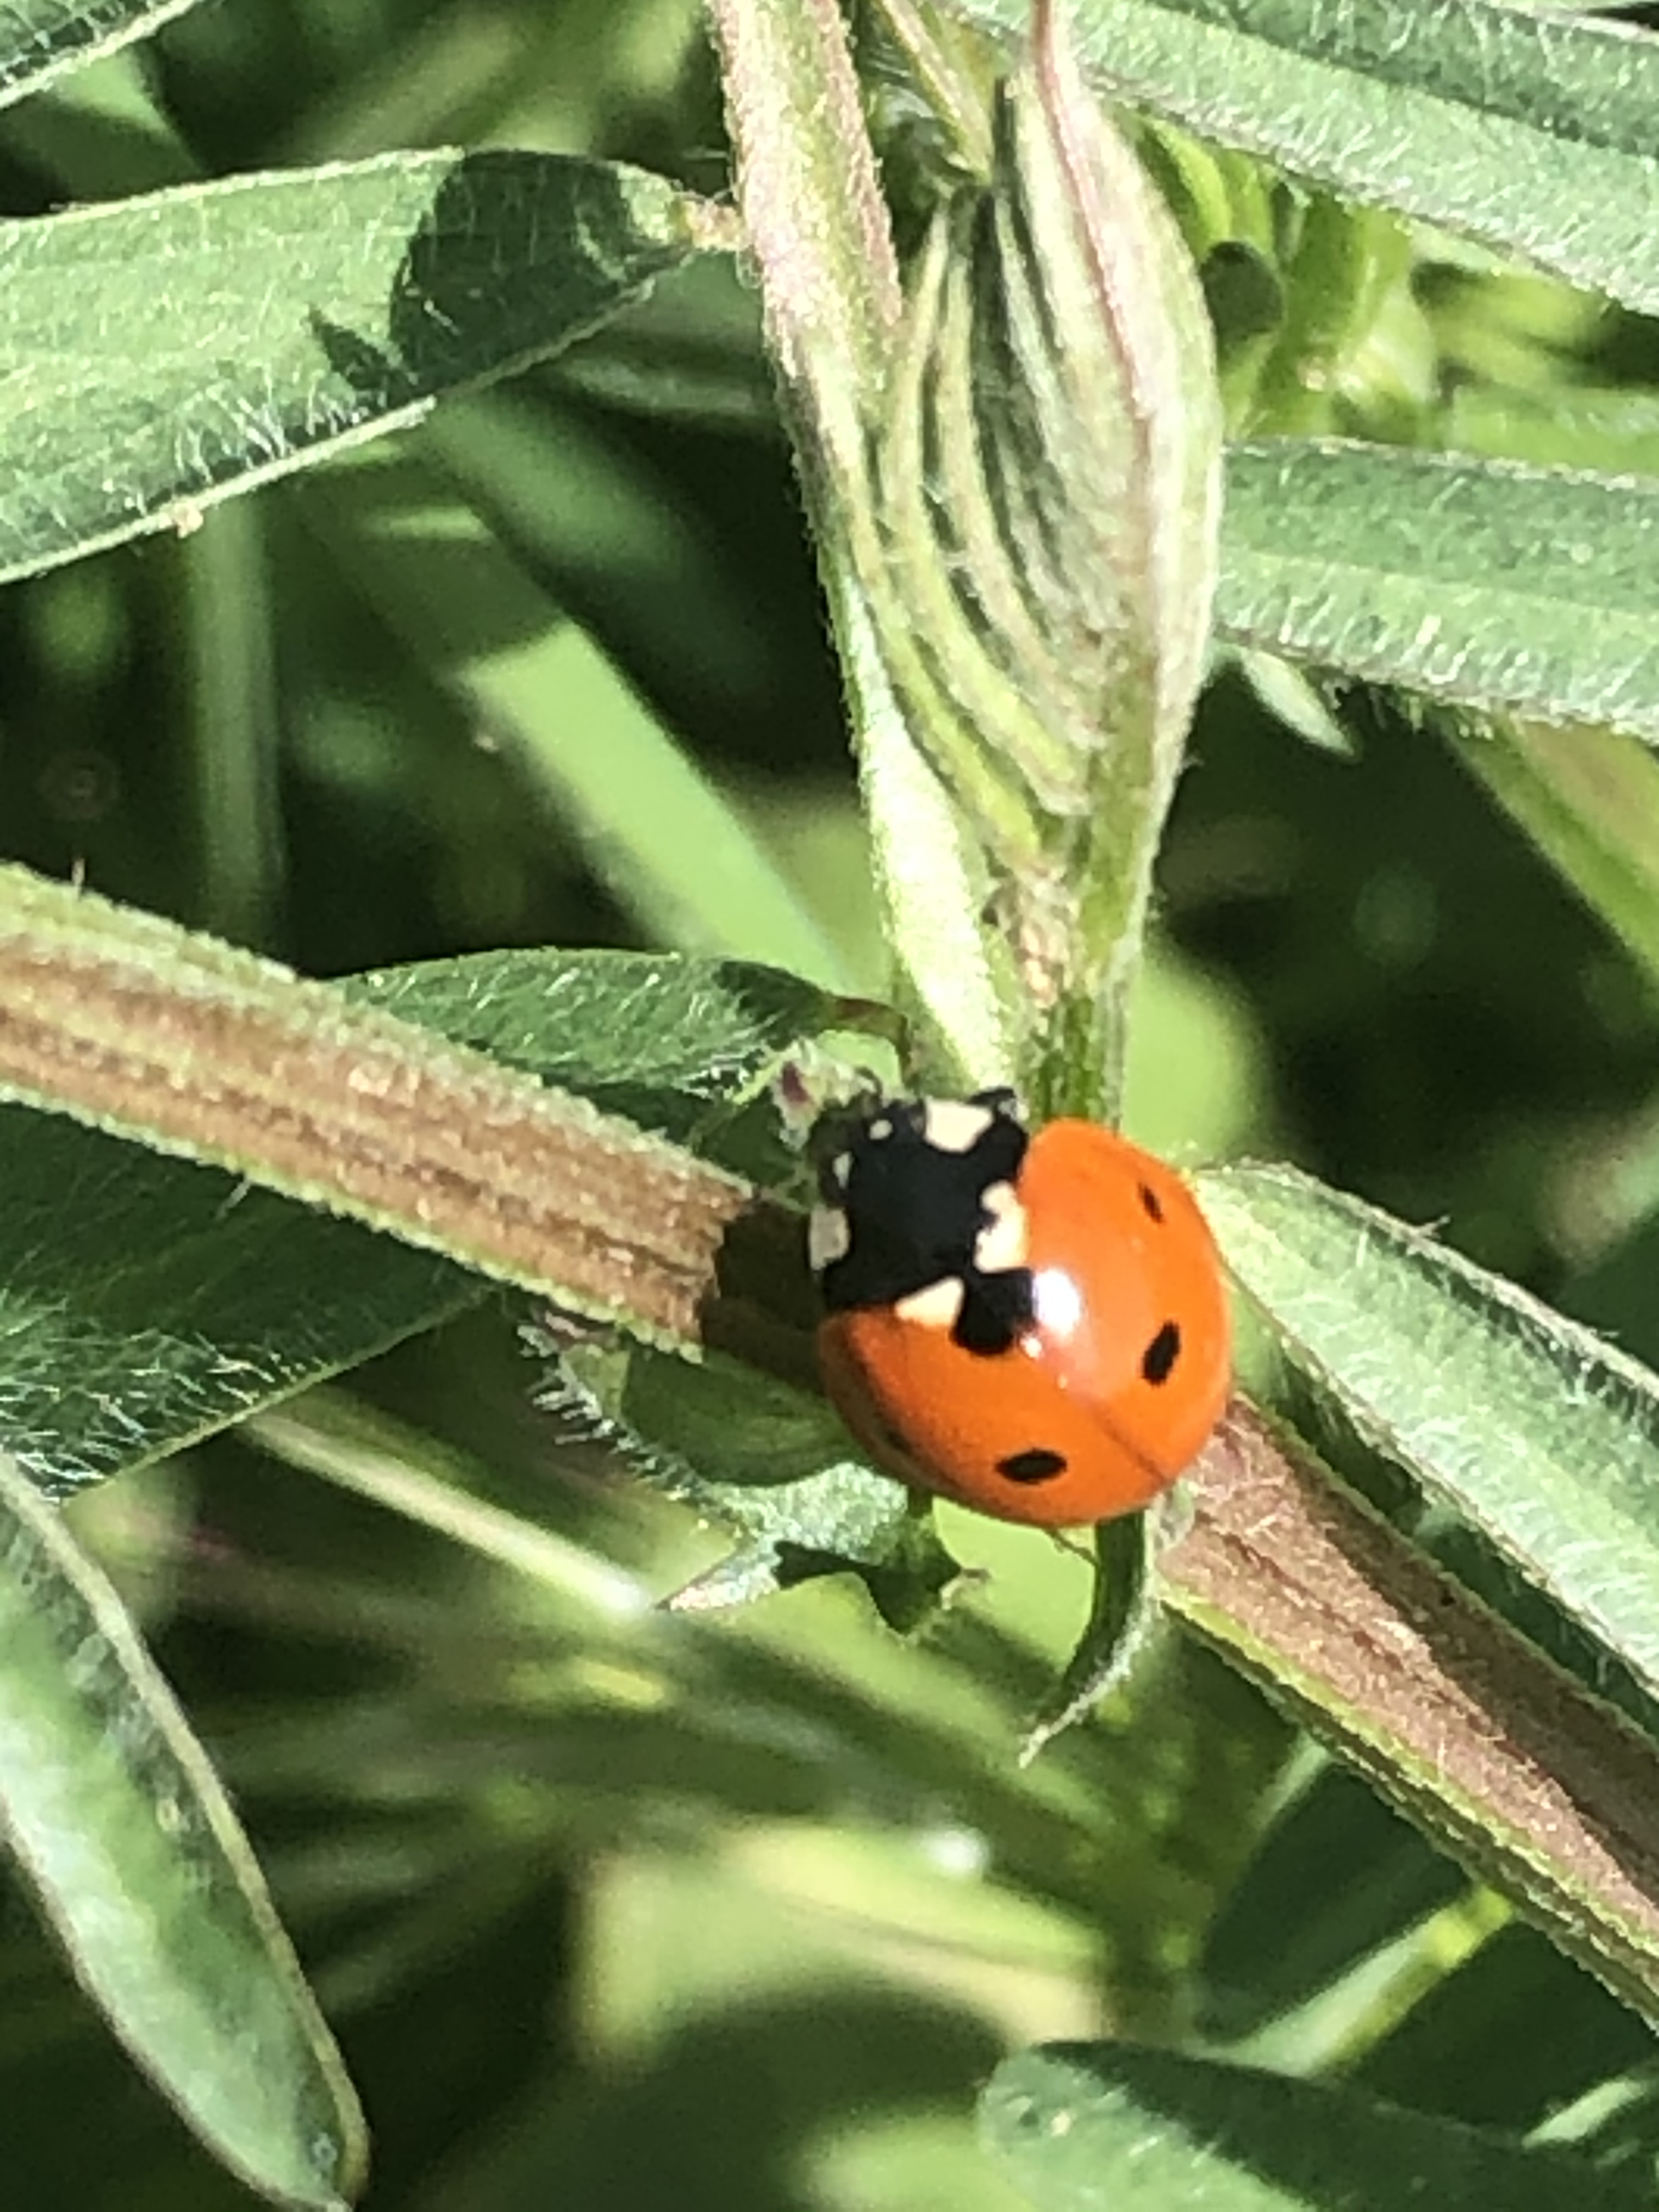
Cover Cropping for Pollinators
and Beneficial Insects SARE​
This research was based on the fact that many beneficial insects need alternate food sources, such as nectar, to sustain themselves when prey are absent. These beneficial insects also typically need vegetation on which to lay eggs or hibernate over the winter. Schomberg, H. 2004.
This is well documented in the case of pecan orchards with a clover understory [14]. The legumes attract aphids, which are followed by beneficial insects. When the clover dies back and the aphid population drops, the beneficial insects are driven up into the trees. These insects, in search of other foods, manage pests on the developing pecans [14]. McCraw, D., and M. Smith
Cowpeas, another legume, are exceptionally heat and drought tolerant. They also have extra-floral nectaries—or nectar-producing glands at leaf stems—which attract beneficial insects.
Lady beetle eating from extra-floral Nectar gland. Photo: M. Winger
Notes:
This research was based on the fact that many beneficial insects need alternate food sources, such as nectar, to sustain themselves when prey are absent. These beneficial insects also typically need vegetation on which to lay eggs or hibernate over the winter. Schomberg, H. 2004.
This is well documented in the case of pecan orchards with a clover understory [14]. The legumes attract aphids, which are followed by beneficial insects. When the clover dies back and the aphid population drops, the beneficial insects are driven up into the trees. These insects, in search of other foods, manage pests on the developing pecans [14]. McCraw, D., and M. Smith
Cowpeas, another legume, are exceptionally heat and drought tolerant. They also have extra-floral nectaries—or nectar-producing glands at leaf stems—which attract beneficial insects.
Schomberg, H. 2004. Enhancing Sustainability in Cotton Production Through Reduced Chemical Inputs, Cover Crops, and Conservation Tillage. Project funded by USDA-SARE. To access, visit www.sare.org/project-reports and search by project number LS01-121.
McCraw, D., and M. Smith. Use of Legumes in Pecan Orchards. Oklahoma Cooperative Extension Service fact sheet HLA-6250. http://pods.dasnr.okstate. edu/docushare/dsweb/Get/Document-2570/HLA-6250.pdf

Slide 9
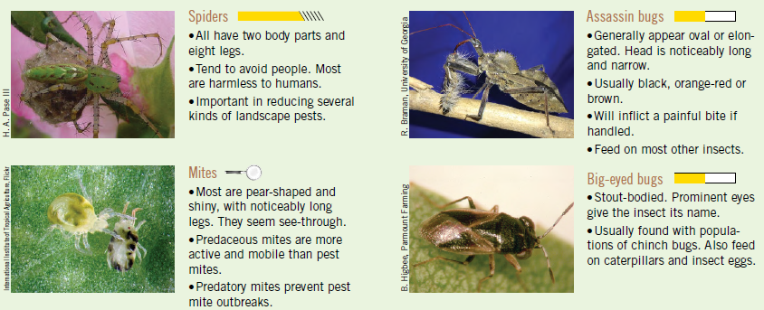
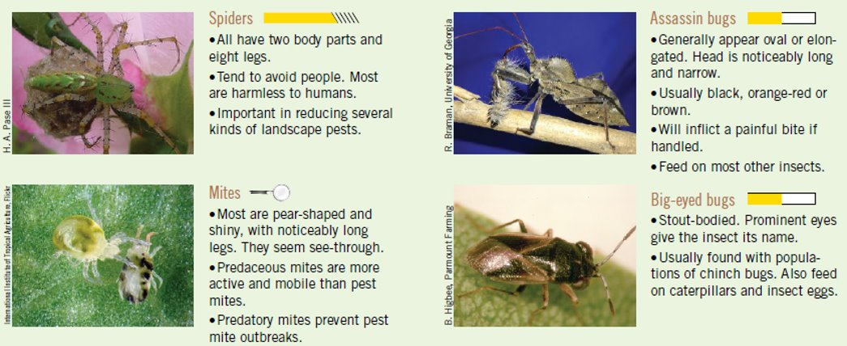
Predator insects in a healthy soil ecosystem
Notes:
Notes are on slide

Slide 10
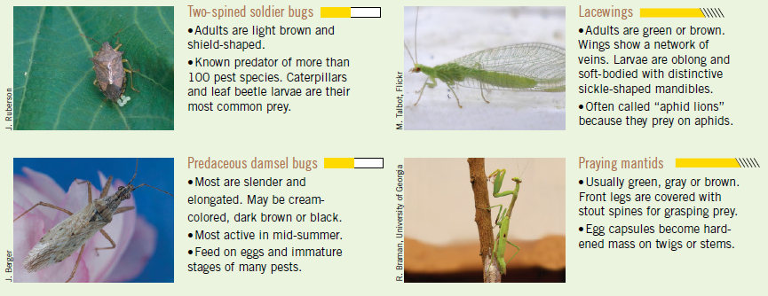

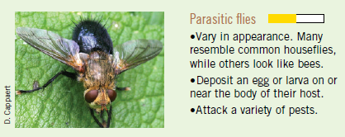
Notes:
Notes on slide

Slide 11
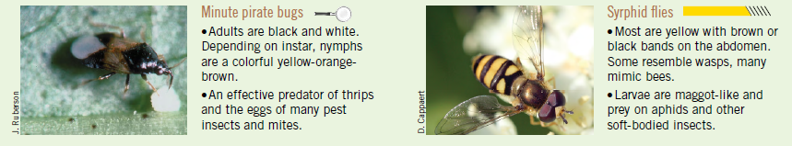
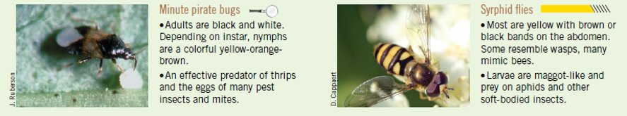
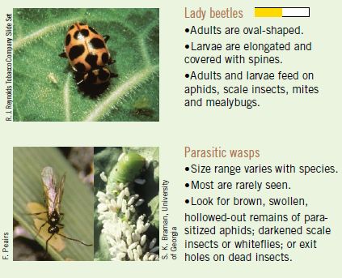
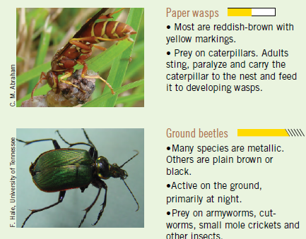
Notes:
Notes on slide

Slide 12
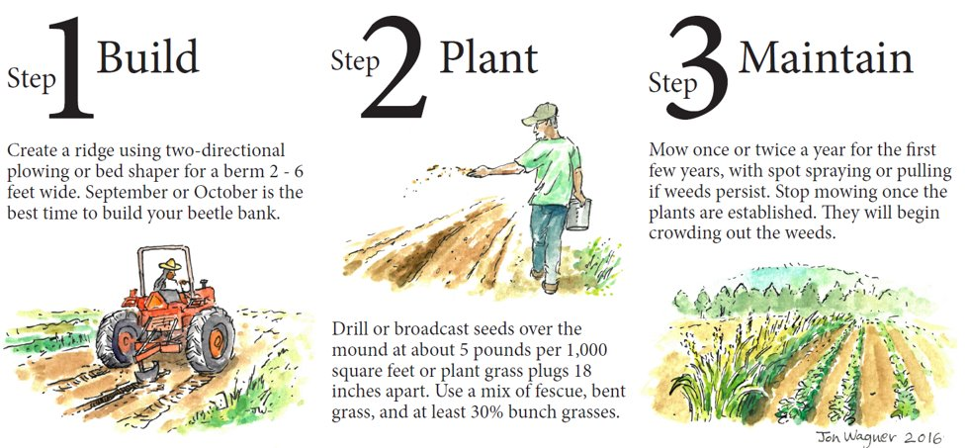

Building a Beetle Bank
Notes:
Notes on slide to build a beetle bank
3 steps to build a beetle bank in a field

Slide 13
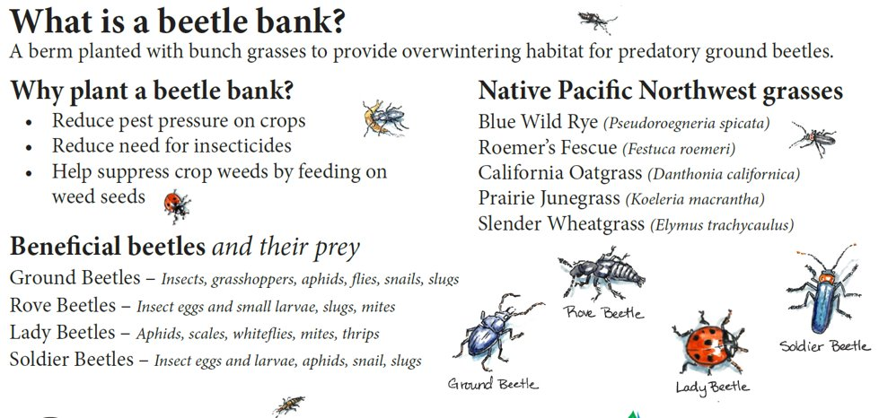
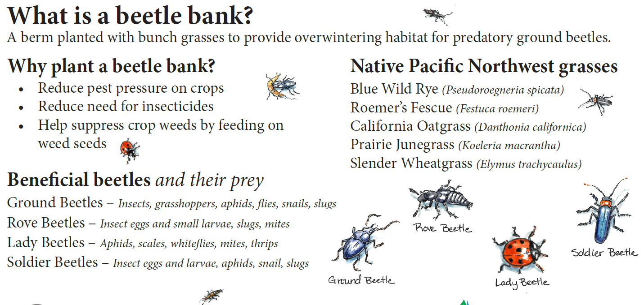
Notes:
Notes on slide

Slide 14
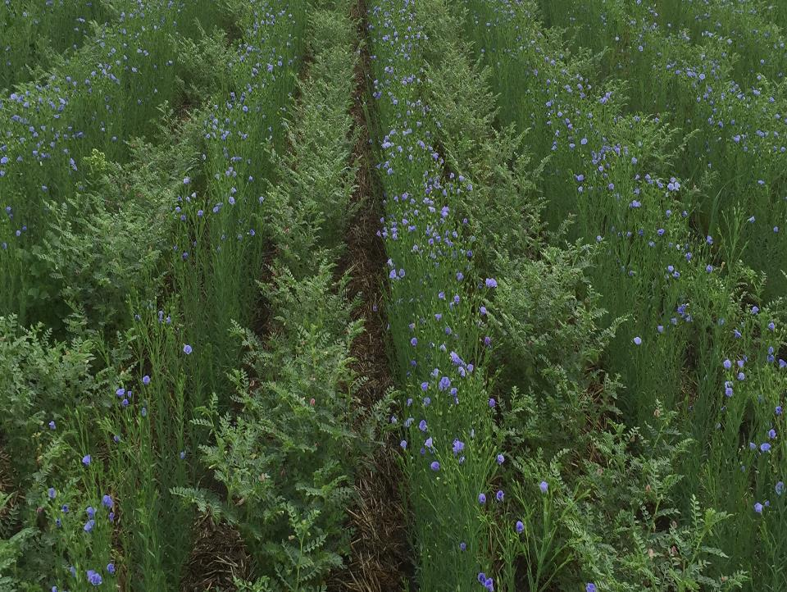

Working With
Mother Nature
Improving Soil Health
Notes:
Axten Farms , Canada. Growing flax with chickpeas in alternate rows, no N fertilizer on broadleaf crops on his farm. when adding diversity, no need for fungicides,
All broadleaf crops are grown with a legume
Picture is blue flax and chick peas growing together, notice the residue on the soil surface

Slide 15
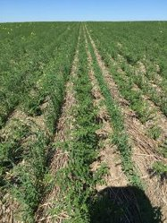
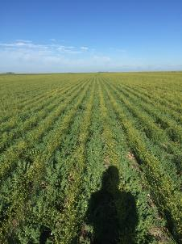
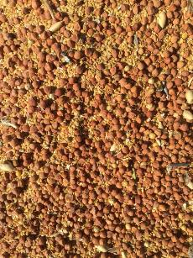
Derek Axten, Saskatchewan, Canada
Crops in Rotation: 7 broadleaf crops wheat, barley, rye
Intercrops we have grown: Benefits
Clearfield Canola / Yellow Peas: Reduced N input/Reduced Harvest Loss
Yellow Mustard / Maple Peas: “”
Yellow Mustard / Red Lentils: “”
Golden Flax / Desi Chickpea: Reduced N&P input in Flax/No fungicide in Chicks
All intercrops never receive fungicide
Notes:
Cost of Nitrogen fertilizer went from 360,000 per year to $26,000
Pics chickpeas and flax – left and center
Right pic peas and canola in combine after harvest
Pictures: Derek Axten

Slide 16
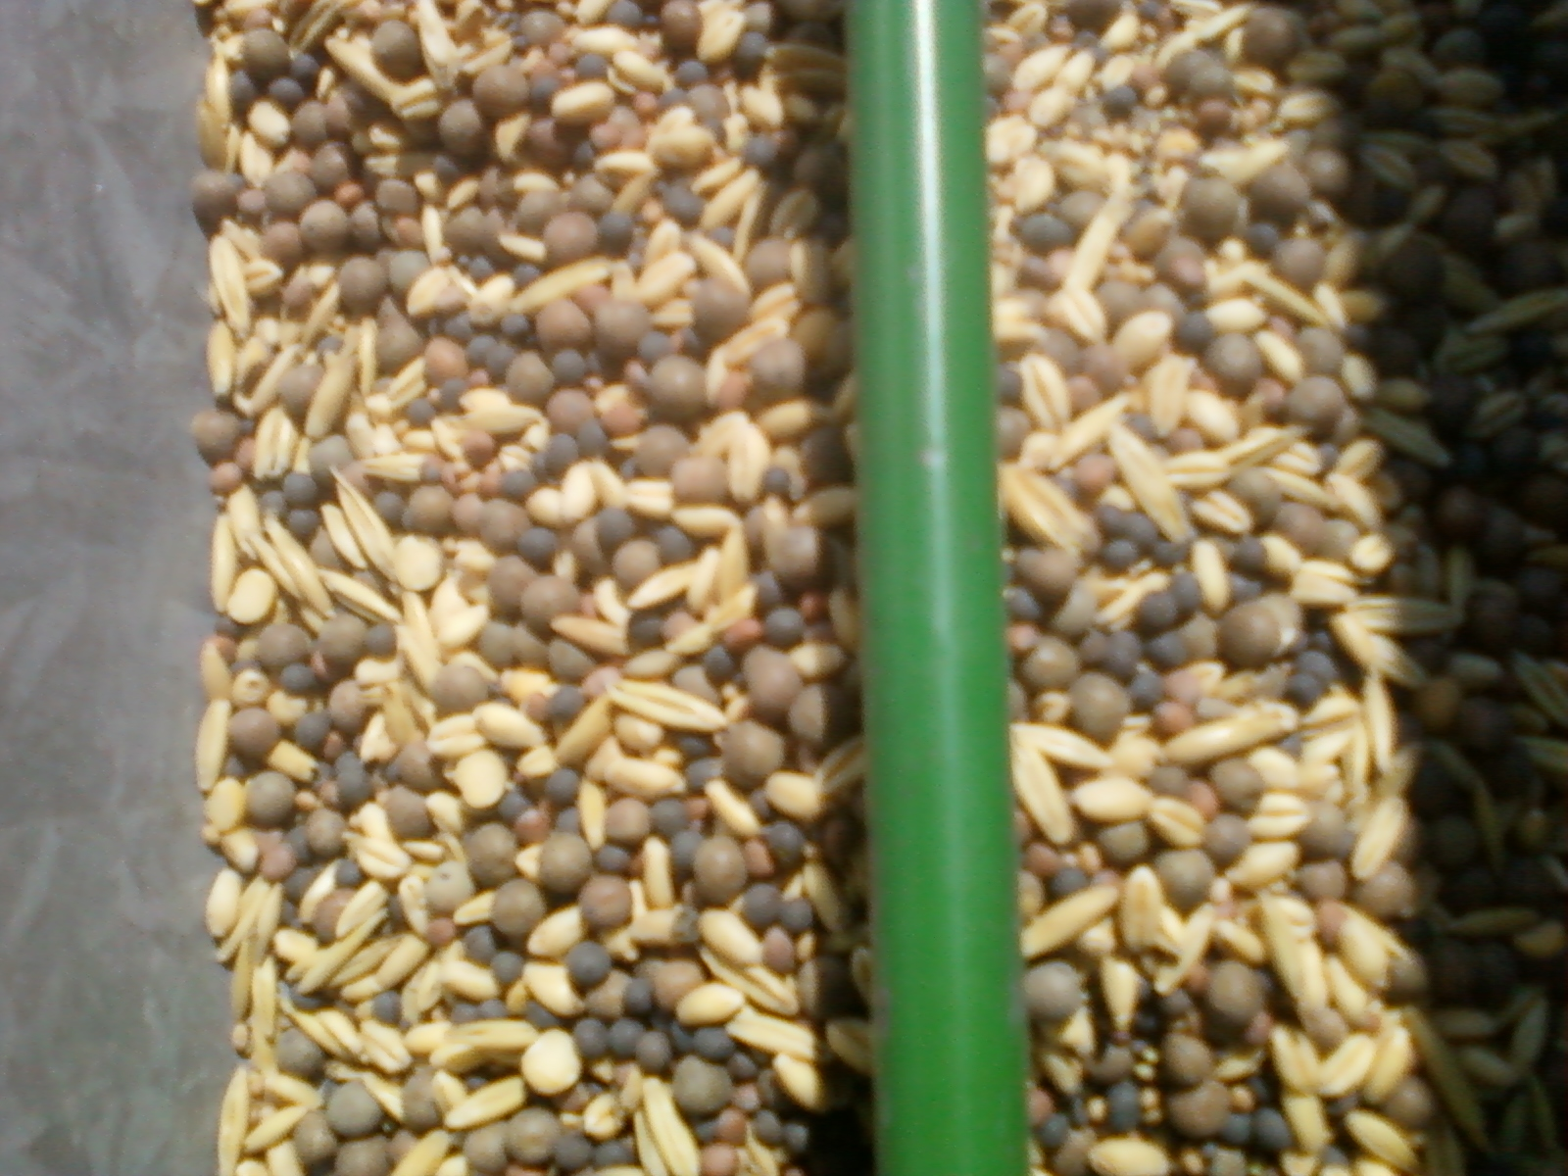

When I plant a multi species mix, how do the seeds stay mixed up in the drill?
Legumes = 60 lbs/bu
Brassicas = 50
Cool season grass = 60
Warm season grass = 50
The seed density average
54 lbs/bu
Notes:
Seed density averaged 54, did not include low weight cool season grasses such as annual ryegrass

Slide 17
Thank you!
For more information on Managing Soil Health,
visit us here:
https://www.nrcs.usda.gov/conservation-basics/natural-resource-concerns/soils/soil-health
USDA is an equal opportunity provider, employer, and lender.

